Slide 1

Shrinking Space for WTO Dispute Settlement: Geopolitics, Forum Shopping, and Lessons for Developing Economies
Authors: M. Faiz Krisnadi & Dama Rifki A.
Presented by M. Faiz Krisnadi
Friday, 12 December 2025

Slide 2
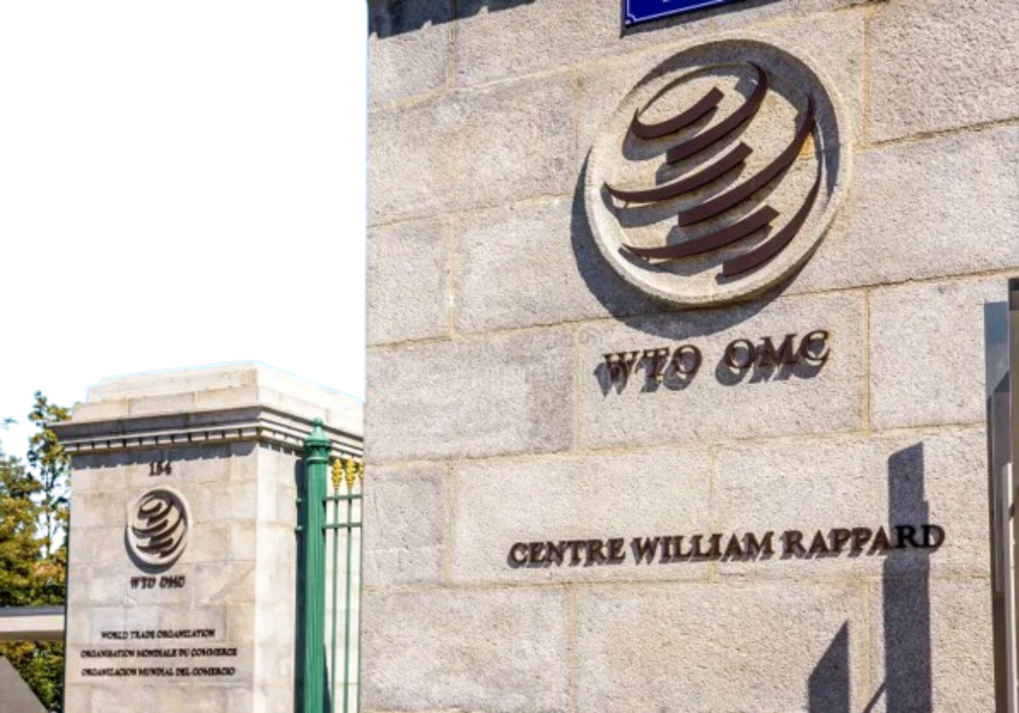
Table of Contents
The Context & Dilemma
Theoretical Framework & Methodology
Case Evidence: A Tale of Three Disputes
Indonesia-EU (Palm Oil)
USA-India (Solar Cells)
Philippines-China (Bananas)
Synthesis of Mechanisms
Policy Implications & Conclusion

Slide 3
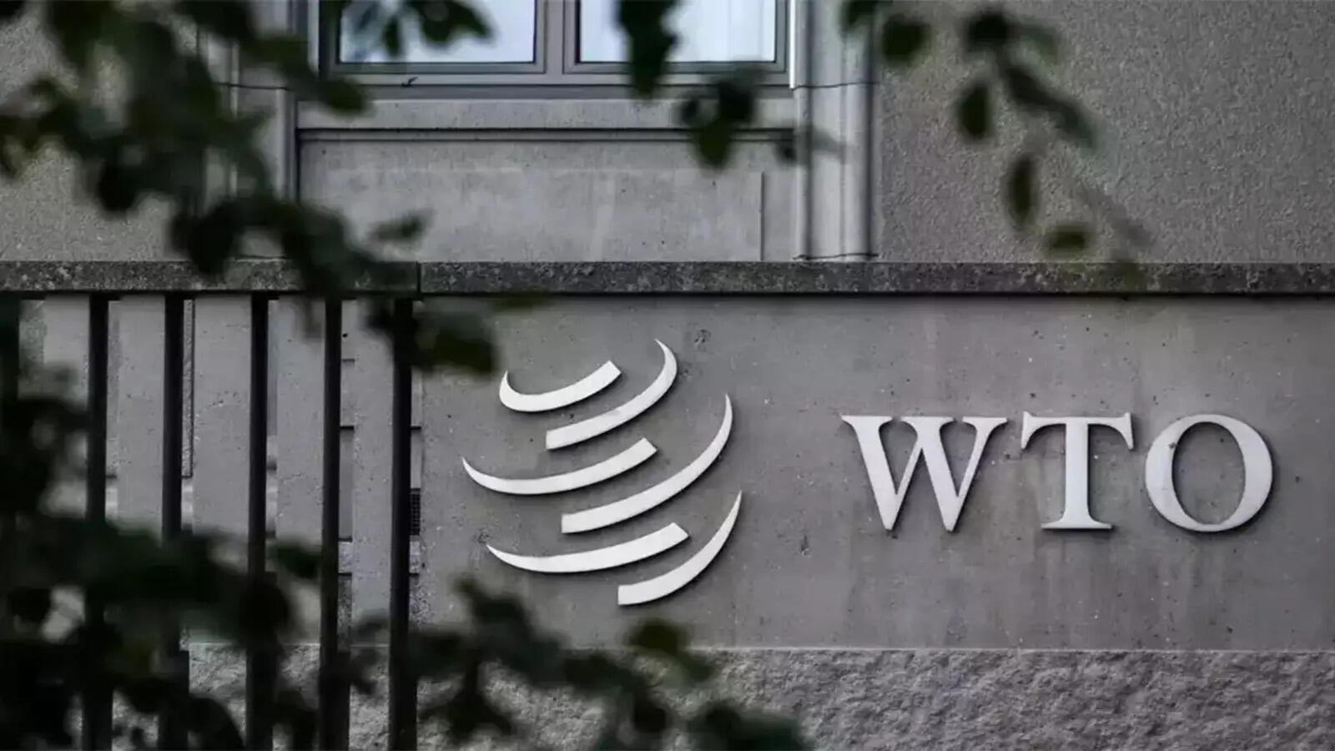
The Context: A "Shrinking Legal Space”
The WTO's "Crown Jewel" is under dual pressure
The Institutional Crisis:
Since Dec 2019, the WTO Appellate Body (AB) has been paralyzed (appointments blocked).
The Result: Losing parties can "appeal into the void," neutralising panel reports and leaving no final ruling.
The Geopolitical Shift:
Resurgence of protectionism driven by rivalry (e.g., US-China), national security claims, and industrial policy.
Large economies increasingly rely on unilateral instruments or bilateral deals.
Bottom line: The rules-based order is fragmenting, squeezing options for smaller economies.

Slide 4
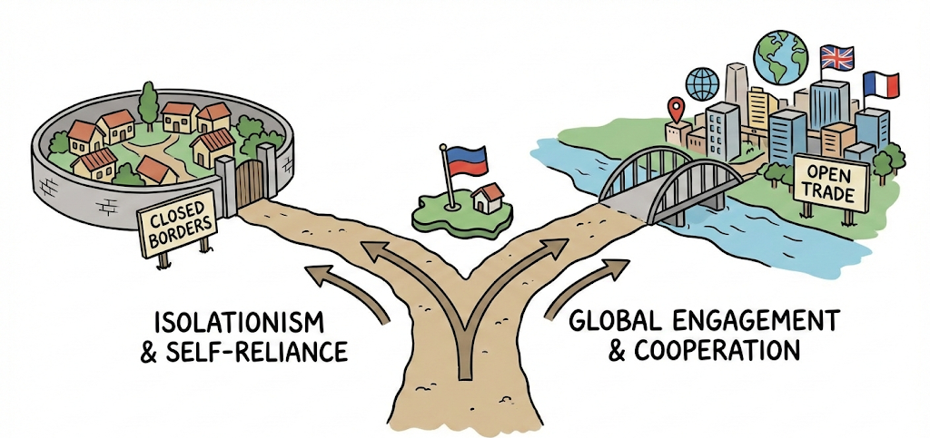
When the multilateral system stalls, weaker members face a strategic dilemma.
The Dilemma for Developing Economies
Developing Countries remain active users of the DSU to challenge unfair practices by larger partners.
The Strategic Choice:
Stay in the broken WTO?
Pros: Legally binding, compulsory jurisdiction, cross-retaliation leverage.
Cons: Slow, uncertain finality due to AB paralysis.
"Forum Shop" elsewhere (RTAs/Ad Hoc)?
Pros: Potentially faster resolution.
Cons: Often "softer" enforcement; risks reverting to power politics.
At Stake: Not just individual disputes, but the integrity of the rules-based system.

Slide 5
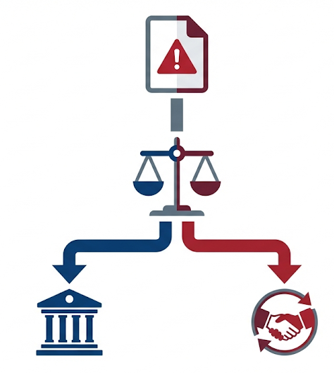
Theoretical Framework & Propositions
Trigger Event: Trade Injury
Geopolitical Filter
Propositions (P)
(High Risk vs. Low Alignment)
P1: Timing Effect
P2: Venue Choice
P3: Enforcement Gap
P1
Low Risk /
High Alignment
High Risk /
Low Alignment
P2
P3
WTO Path
(Formal)
Forum Shopping
(Exit)

Slide 6
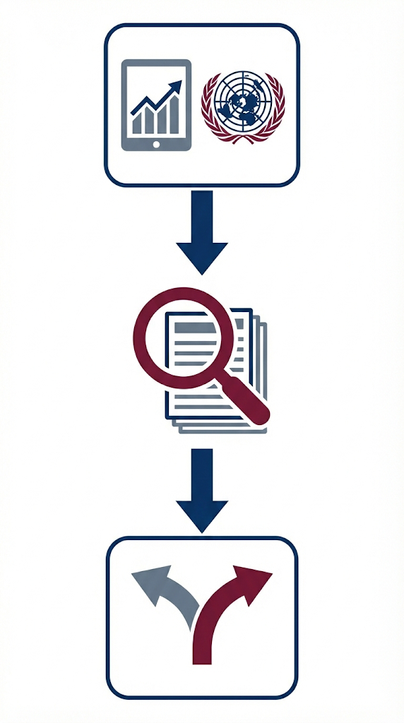
Methodology & Data Toolkit
A Mixed-Methods Approach:
Structured Focused Comparison (SFC) of three recent disputes.
Exploratory small-N quantitative tests.
Key Data Sources:
⚖️ WTO Dockets: For reconstructing precise timelines (consultations, panels, reports).
📈 Caldara-Iacoviello GPR Index: To measure geopolitical risk spikes.
🇺🇳 UNGA Voting Data (Bailey et al.): To measure diplomatic alignment/divergence.
🚢 Trade Data (Comtrade/Eurostat): To establish economic stakes.

Slide 7
Case Evidence Overview: A Tale of Three Disputes
Variable | Case 1: Indonesia-EU 🌴 | Case 2: USA-India ☀️ | Case 3: Philippines-China 🍌
Commodity Stake (The Control) | High Stake (Palm Oil, ~€2bn) | Strategic Stake (Solar Precedent) | High Stake (Major Export)
Geopolitics (IV) (The Cause) | Low Risk Moderate Alignment | Mod. Risk High Alignment | High Risk Low Alignment
Venue Choice (DV) (The Result) | ✅ WTO (Delayed) | ✅ WTO (Fast) | ❌ Exit (No Filing)

Slide 8

Case 1 Analysis: Indonesia-EU (Palm Oil)
Stakes: Key export for Indonesia (~€2bn/yr to EU).
Geopolitics: Low GPR. Dispute driven by environmental/trade policy clashes, not high security.
Timeline & Venue (WTO Path):
Trigger ('19) → Consultations (Dec '19) → [LONG DELAY: Paused waiting for AB reform] → Panel Est. (Jul '20) → Report (Jan '25).
Outcome:
Indonesia won the panel ruling. EU did not appeal.
Enforcement: Legally "Strong," but the lack of appellate review weakens the deterrent effect pending compliance.
Theoretical Implications:
✅ Supports P2 (Venue Choice): Low Geopolitical Risk allowed Indonesia to utilize the formal WTO path despite the power asymmetry.
⚖️ Nuances P1 (Timing): The observed delay was driven by institutional uncertainty (waiting for AB reform), not the geopolitical fear predicted by P1.

Slide 9

Case 2 Analysis: USA-India (Solar)
Stakes: US export stake small, but strategically important to set precedent against localization.
Geopolitics: Moderate GPR and Alignment between partners.
Timeline & Venue (WTO Path):
Trigger → Consultations (Feb '13) → [Relatively FAST Process] → Panel/AB Report → Adoption (Oct '16).
Outcome:
India complied by removing the measure in 2017.
Enforcement Complexity: US later imposed global safeguard tariffs ('18) unrelated to the dispute, eroding commercial gains.
Theoretical Implications:
✅ Supports P2 (Venue Choice): High Diplomatic Alignment facilitated a standard, relatively fast WTO litigation process.
🔄 Complicates P3 (Enforcement Gap): Demonstrates that "strong" legal enforcement does not guarantee commercial victory (gains were eroded by subsequent safeguards).

Slide 10

Case 3 Analysis: Philippines-China (Bananas)
Stakes: Major export to China. Single-buyer dependence increased vulnerability to coercion.
Geopolitics: High GPR (Scarborough Shoal security crisis) and Low Alignment.
Timeline & Venue (Non-WTO Path):
Trigger (Mar '12) → [NO WTO FILING: Feared Retaliation/Escalation].
Shifted to political dialogue and market diversification.
Outcome:
Restrictions eased in 2016 only after a diplomatic thaw.
Enforcement: "Weak." No formal ruling; solution dependent entirely on goodwill.
Theoretical Implications:
✅ Strongly Confirms P1 (Timing): High Security Risk caused "infinite delay" (total avoidance of filing a case).
✅ Confirms P2 (Venue) & P3 (Enforcement): The forced shift to political channels resulted in a "soft," unenforceable outcome dependent on goodwill.

Slide 11
Results Synthesis & Mechanisms
The "Secret Sauce": Why Geopolitics Matters.
 | Low Alignment | High Alignment
High Risk | THE EXIT ZONE ⛔ (Forum Shopping) Philippines-China 🍌 "Fear of Escalation dominates" | (Theoretical Empty Zone) High risk but high trust is rare in trade disputes
Low Risk | THE DELAY ZONE ⏳ (Institutional Wait) Indonesia-EU 🌴 "Willing to sue, but stuck." | THE WTO ZONE 🏛️ (Standard Litigation) USA-India ☀️ "Trust allows legal battle."

Slide 12
Policy Implications for Developing Economies
Near-Term Actions (Unilateral/Coalition) | System-Level Reforms (Long-Term)
☑️ Make Regional Mechanisms Usable: Adopt standard protocols, timelines, and snap-back clauses in RTAs. | 🏛️ Restore WTO Appellate Function: Crucial for small states to ensure uniform jurisprudence and prevent defection by large players.
☑️ Pre-commit to Filing Triggers: Use internal guidelines to reduce politically motivated delays. | 🔄 Integrate Trade & Diplomacy Strategy: Diversify export markets to reduce vulnerability and leverage political tracks alongside legal ones.
☑️ Invest in Legal Capacity: Build "evidence vaults" and utilize advisory centers.
☑️ Build Coalitions: Pool resources for joint stances (e.g., ACP, ASEAN).

Slide 13
Key Takeaways
Geopolitics shrinks the "legal space" for dispute settlement.
The paralysis of the WTO Appellate Body, combined with rising geopolitical risk, nudges weaker states toward faster yet softer alternatives.
The Challenge: To avoid reverting to pure power politics, developing economies must actively manage this new reality.
The Path Forward: Strengthen alternative fora and leverage coalitions in the near term, while relentlessly pushing for the multilateral reform necessary to restore a rules-based order.

Slide 14
Appendix

Slide 15
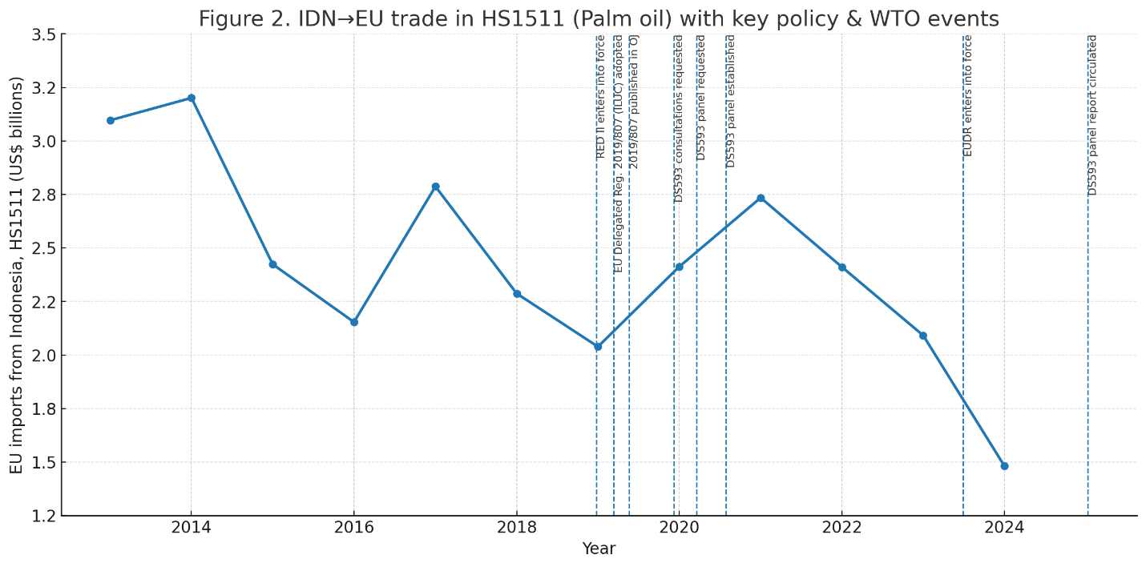
Appendix 1. IDN–EU palm oil: HS1511 trade trend + event markers.
Note. Series shows EU imports of Indonesian palm oil over the period displayed (value in USD as labelled). Vertical markers denote: policy trigger (RED II/Delegated Regulation—high-ILUC classification), WTO consultations, panel establishment, panel report circulation, and DSB adoption. Where both value and volume are shown, value is plotted on the right axis and volume on the left.

Slide 16
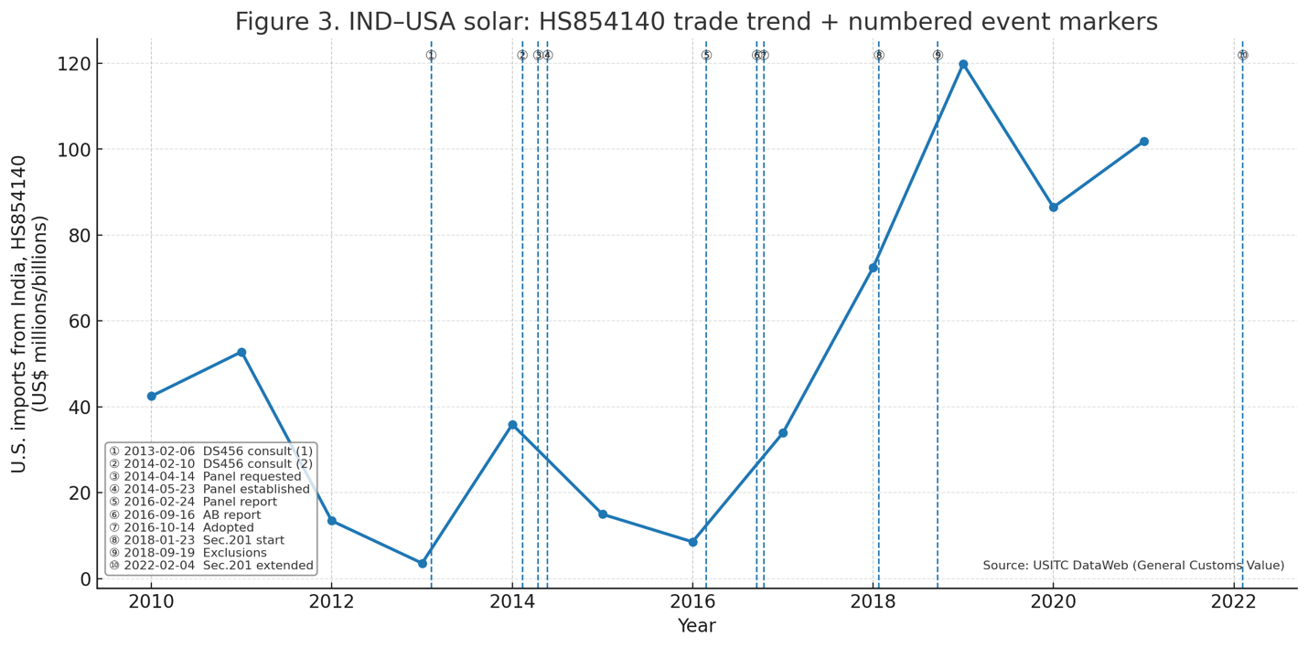
Appendix 2. Timeline: USA-India Solar Trade & Disputes.
Note. Series shows U.S. imports of solar cells/modules from India over the period displayed (value in USD; optionally volume if included). Vertical markers denote: WTO consultations, panel establishment, panel report, AB report/adoption, and, for context, the 2018 U.S. safeguard (Section 201). Where both value and volume are shown, value is on the right axis, volume on the left.

Slide 17
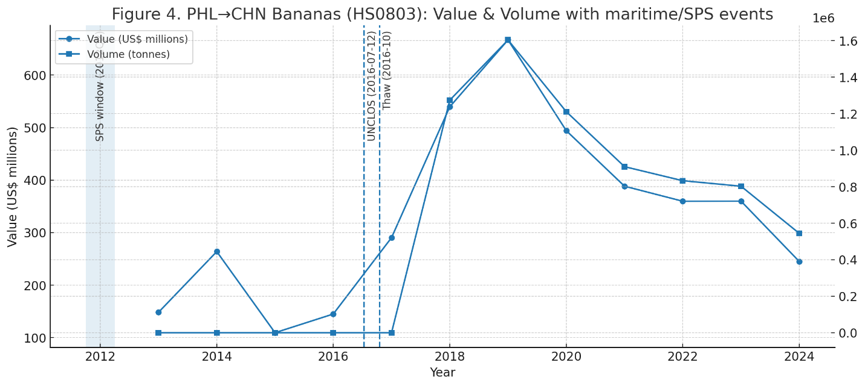
Appendix 3. PHL–CHN bananas: HS0803 trend + maritime frictions.
Note. Circle-line = export value (FOB, US$ millions); square-line = export volume (tonnes). The shaded band marks the Scarborough Shoal/SPS inspections window (Apr–Jun 2012). Dashed lines mark the UNCLOS award (12 July 2016) and the October 2016 diplomatic thaw. Data are annual; volume is derived from net weight (kg) and converted to tonnes.

Slide 18
Appendix 4. Event-timing regressions (Supportive Exploratory Evidence).
Model | N | R² | const | gpr_spread | align_diff_usa
(1) ln(days) ~ GPR spread | 5 | 0.100 | 10.530 (2.226) | −0.024 (0.013) | —
(2) ln(days) ~ alignment diff (USA) | 5 | 0.020 | 3.029 (4.787) | — | 2.930 (6.506)
(3) ln(days) ~ GPR spread + alignment diff | 5 | 0.146 | 22.007 (44.062) | −0.048 (0.101) | −7.904 (28.744)
Notes: DV = ln(days between WTO milestones). Robust (HC1) SEs in parentheses. ‘—’ denotes a regressor not included in that specification. Covariates measured at the start of each interval: GPR spread (Caldara–Iacoviello GPR) and UNGA alignment (USA) difference (Bailey–Strezhnev–Voeten). WTO milestones follow consultations → panel → (AB) → adoption.

